Slide 1
SearGroup Trust for Medication
Book Appointments now with SearGroup

Slide 2
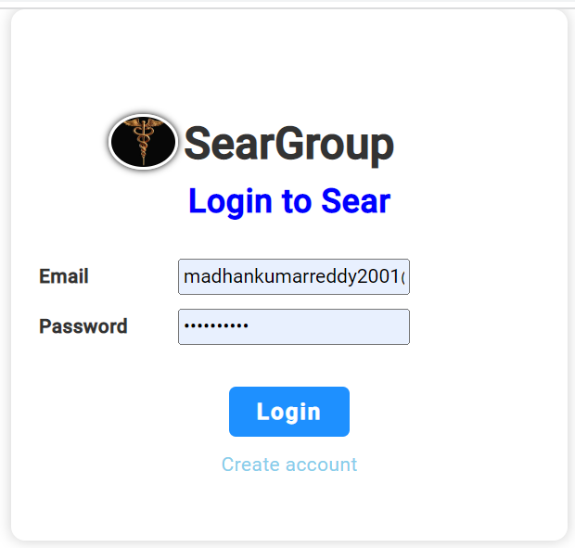
App
admin
user

Slide 3
PostMan Api
Admin-
Generate Username&Password
User-
Generate Username&Password

Slide 4
USER PAGE
Home
&
Book Appointment
Medication
LabTests
Complaints
Home
Medication Details
List of Doctors
Profile of each Doctor
Footer

Slide 5
Medication
View Appointments
List of Medicines
Medical details

Slide 6
LabTests
List of Tests
Book for Test
View forms in Admin

Slide 7
Complaint Form
User to raise complaint
Admin to View Complaints

Slide 8
ADMIN PAGE
Home
Patients
Complaints

